Slide 1
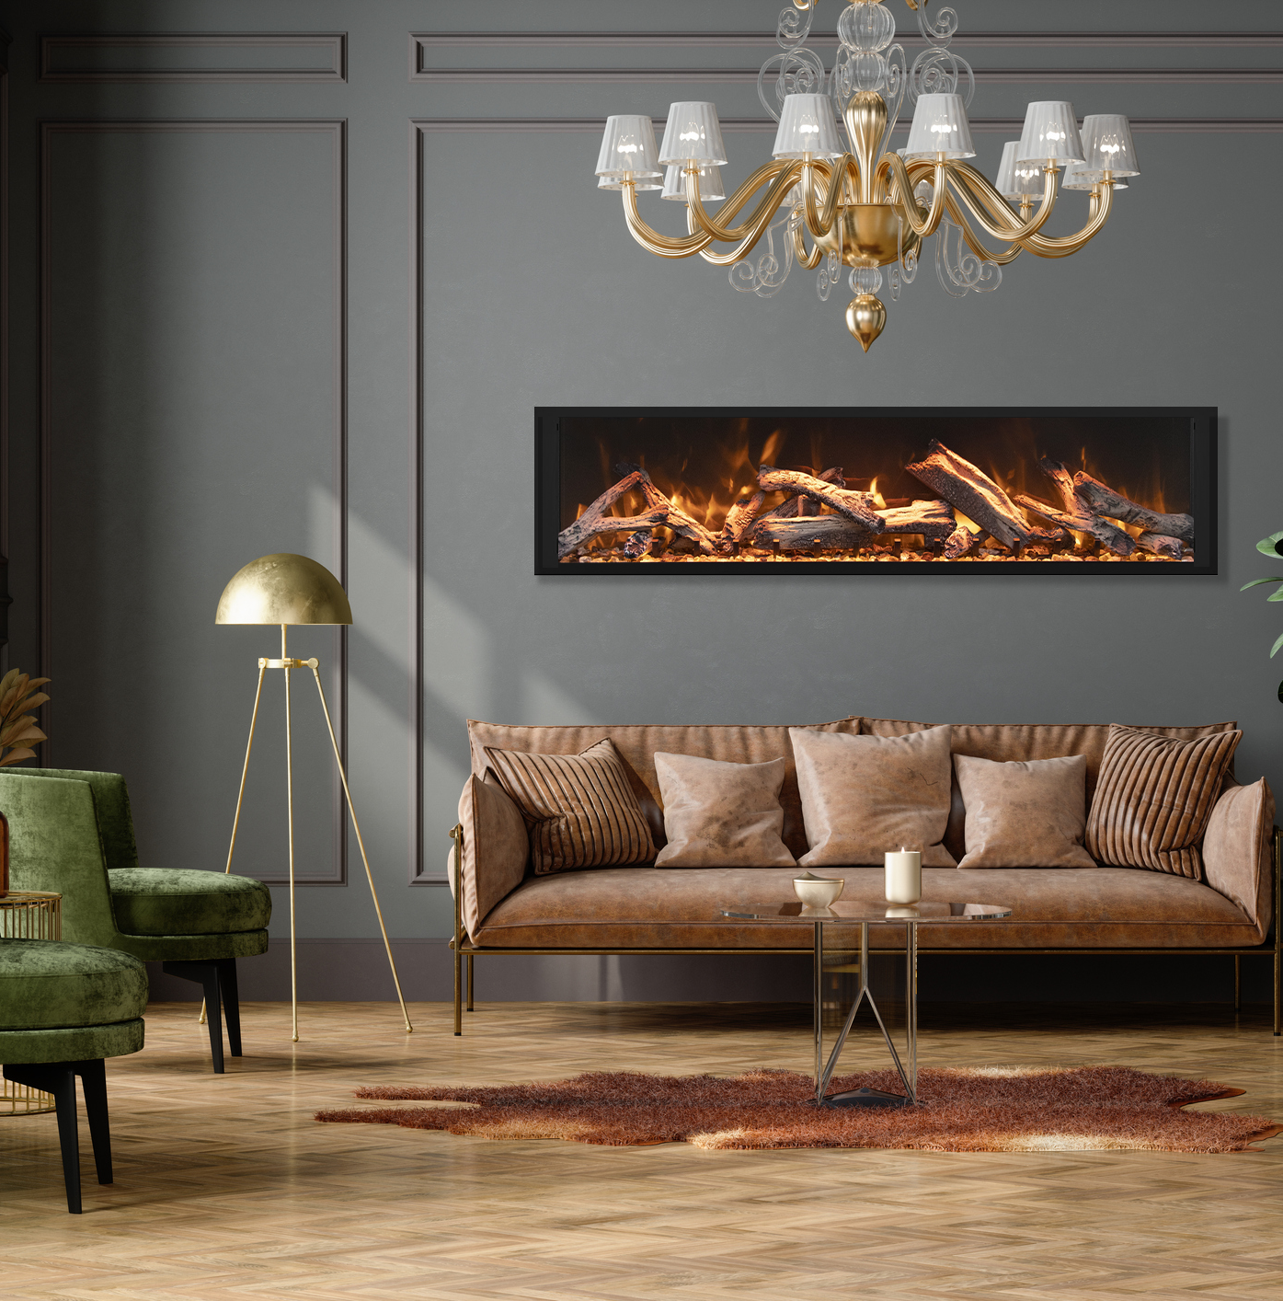
Remii Fireplaces
WWW.REMII.COM

Slide 2
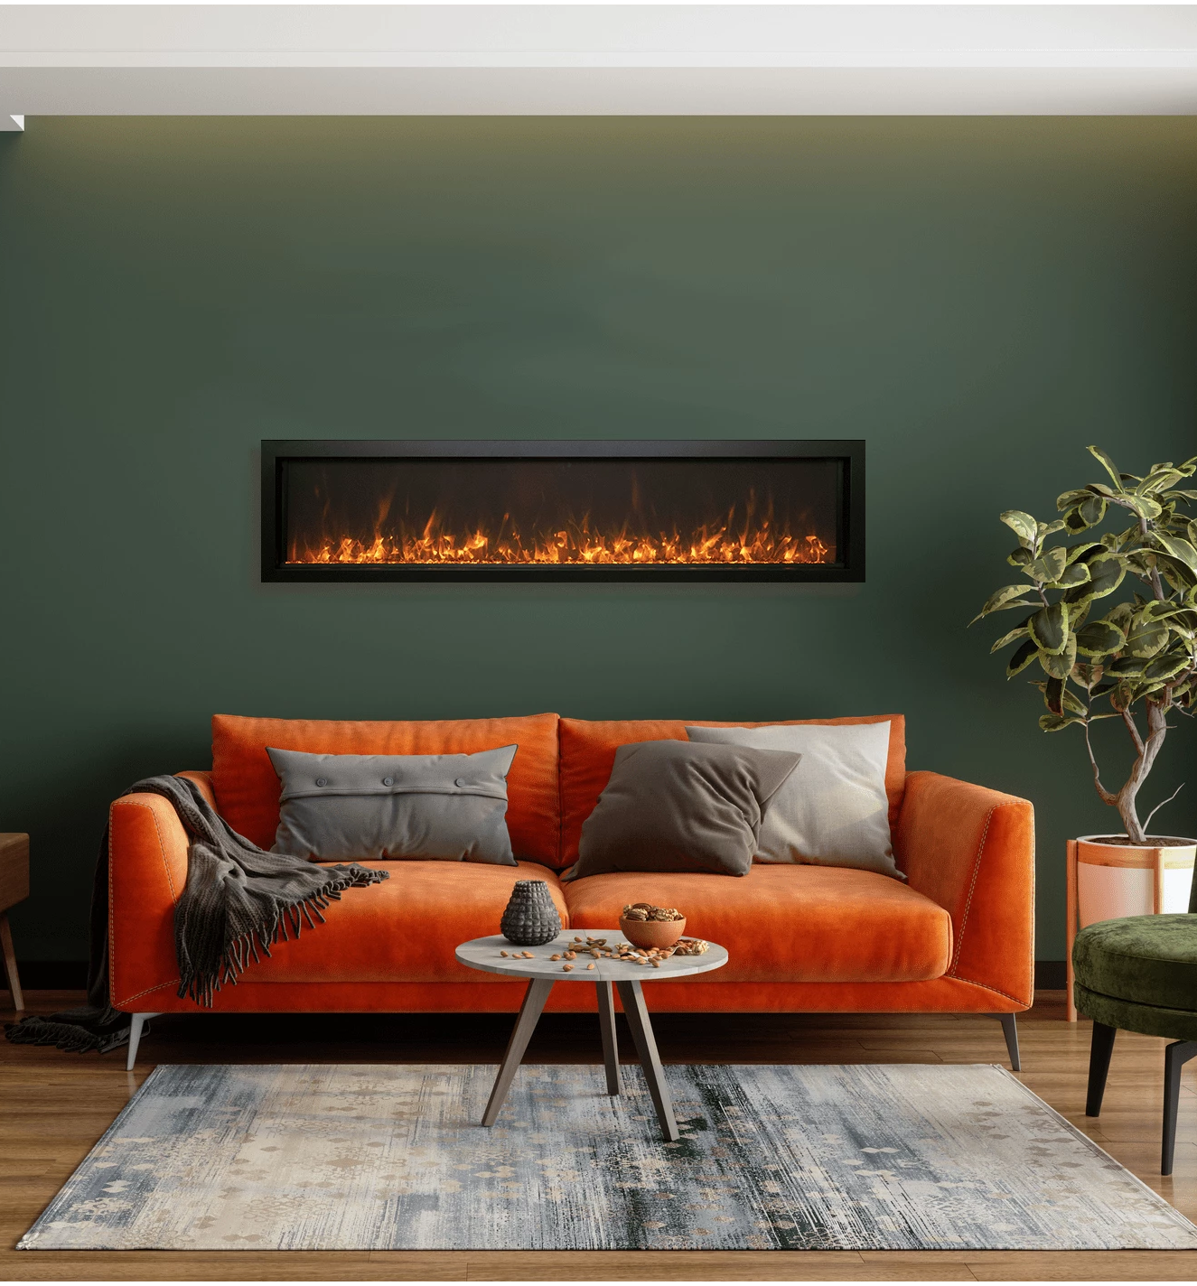
Remii Extra Slim Electric Fireplace

Slide 3
Remii Extra Slim Electric Fireplace
Sizes : 35 Inch, 45 Inch, 55 Inch, 65 Inch
All models are rated for either indoor/outdoor applications
State of the art flame presentation: Vibrant, multi-colored state of the art flame
presentation – change from Yellow to Orange to Red with just a click of the remote.
Very thin – only 4” in-depth
2 Stage heater
Hardwire ready
Thermostat hard-wire ready
Can produce up to 5000 BTU of heat, enough to heat up to 500 sq feet
Flame can operate without heat
Single remote control for flame & heater included
Full frame viewing – unit allows for choice of finishing material to come right to the glass
Optional black steel surround comes in the box, it is up to you if you want to use it or not

Slide 4
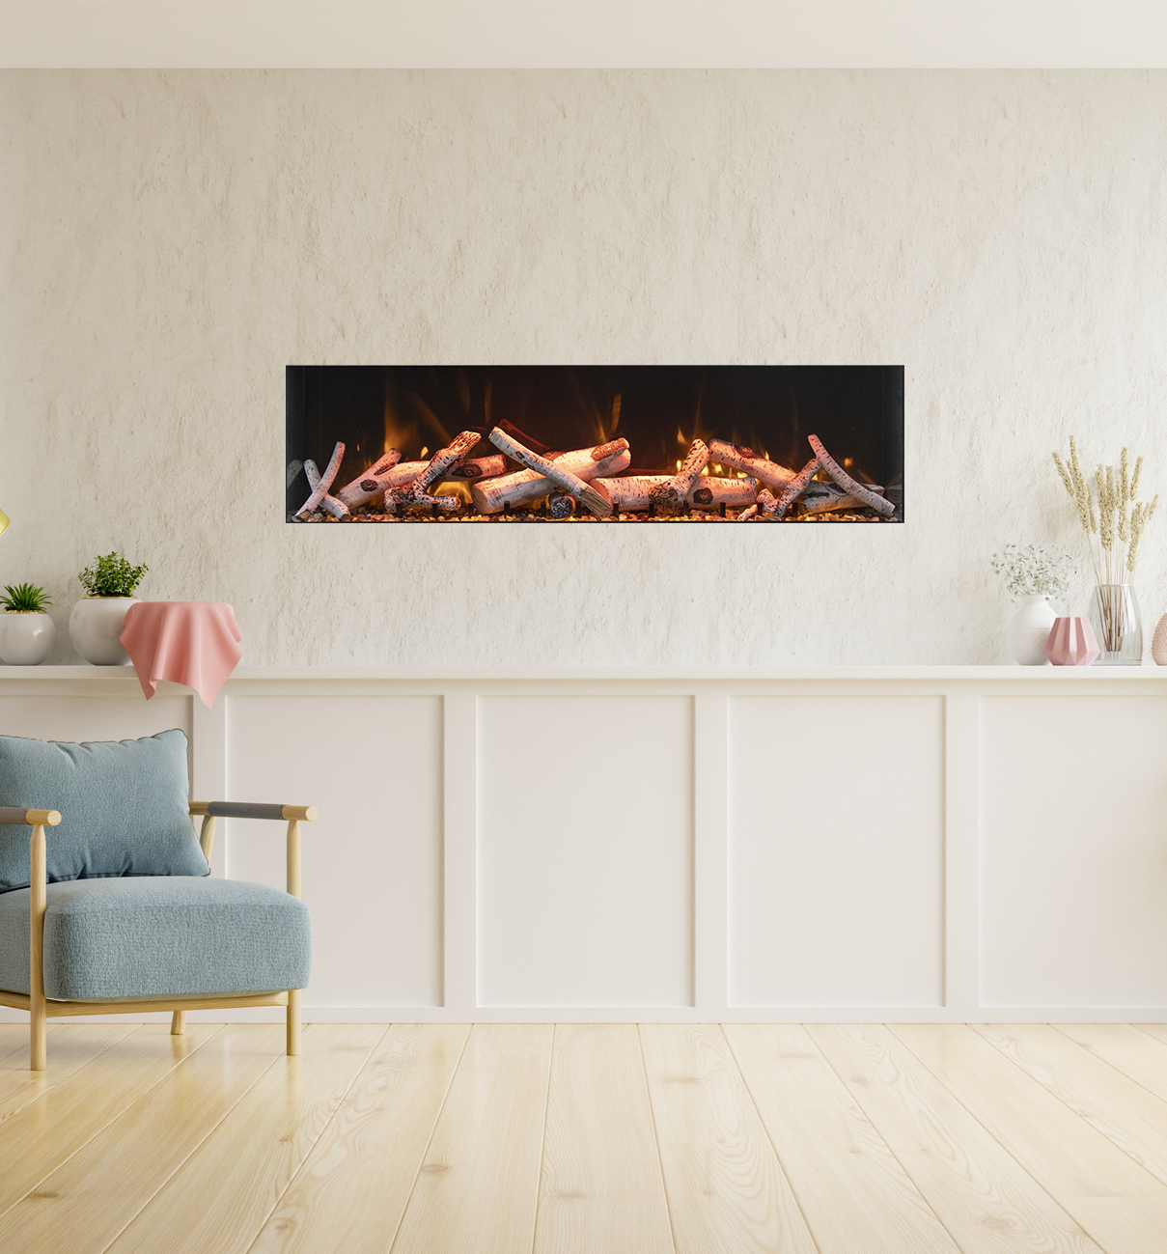
Remii DEEP Electric Fireplace

Slide 5
Remii Deep Electric Fireplace
Sizes: 45 Inch, 55 Inch, 65 Inch
All models are rated for either indoor/outdoor applications
Cover MUST be purchased for outdoor installations
State of the art flame presentation: Vibrant, multi-colored state of the art flame presentation – change from Yellow to Orange to Red with just a click of the remote.
Ambient Canopy lighting in 13 colors
DEEP models have 2 flame sets
2 Stage heater
Hardwire ready
Thermostat hard-wire ready
Can produce up to 5000 BTU of heat, enough to heat up to 500 sq feet
Flame can operate without heat
Single remote control for flame, ambient canopy lighting & heater included
Full frame viewing – unit allows for choice of finishing material to come right to the glass Optional black steel surround comes in the box, it is up to you if you want to use it or not

Slide 6
Remii EXTRA TALL Electric Fireplace

Slide 7
Remii Extra Tall Electric Fireplace
Sizes : 45 Inch, 55 Inch, 65 Inch
All models are rated for indoor or outdoor applications
Incredible 17 3/4″ high viewing area
Black glass side panels
Mirrored media tray
State of the art flame presentation: Vibrant, multi-colored state of the art flame presentation – change from Yellow to Orange to Red with just a click of the remote.
Ambient Canopy lighting in 13 colors
DEEP models have 2 flame sets
2 Stage heater
Hardwire ready
Thermostat hard-wire ready
Can produce up to 5000 BTU of heat, enough to heat up to 500 sq feet
Flame can operate without heat
Single remote control for flame, ambient canopy lighting & heater included
Full frame viewing – unit allows for choice of finishing material to come right to the glass
Optional black steel surround comes in the box, it is up to you if you want to use it or not

Slide 8
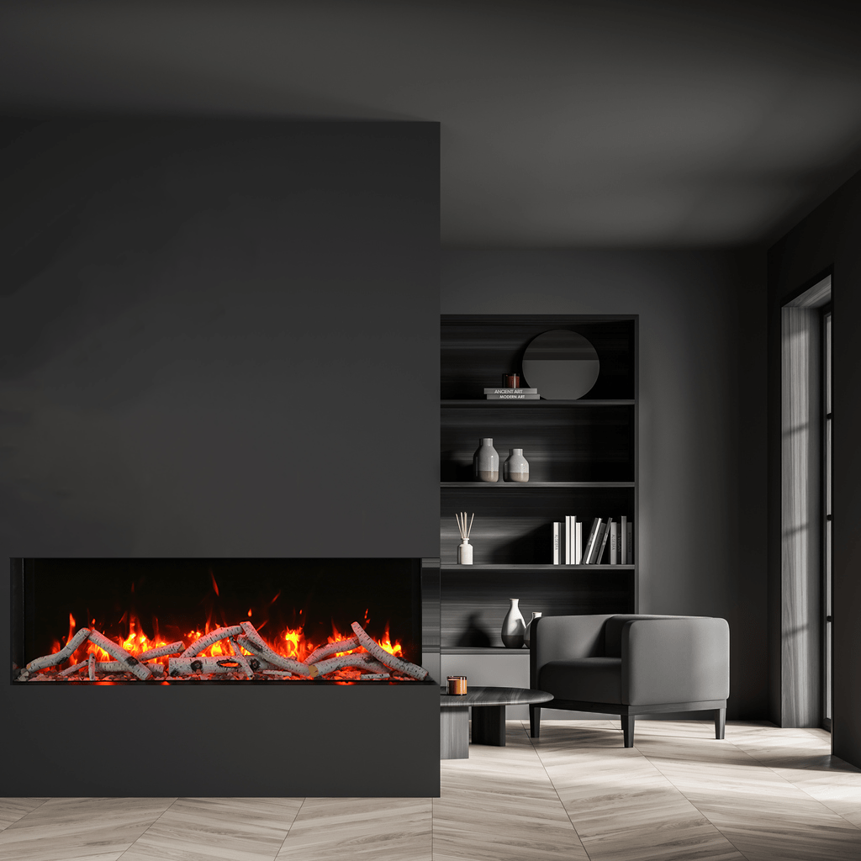
Remii BAY-SLIM
Electric Fireplace

Slide 9
Remii BAY-SLIM Electric Fireplace
Sizes : 30 Inch, 40 Inch, 50 Inch, 60 Inch, 72 Inch
Can be installed into a 5.08cm x 10.16cm Wall.
Very thin – only 10.16cm depth and multiple length options.
All models are rated for indoor or outdoor applications.
Flame Presentation: State of the art flame presentation: Vibrant, multi color state of the art flame presentation – change to yellow, orange or red flames with just a click of the remote.
3 Speed motor sets the flame speed option.
WiFi controls come standard.
Perfect for zone heating. Approximately 500 sq. ft., 5000 BTUs

Slide 10
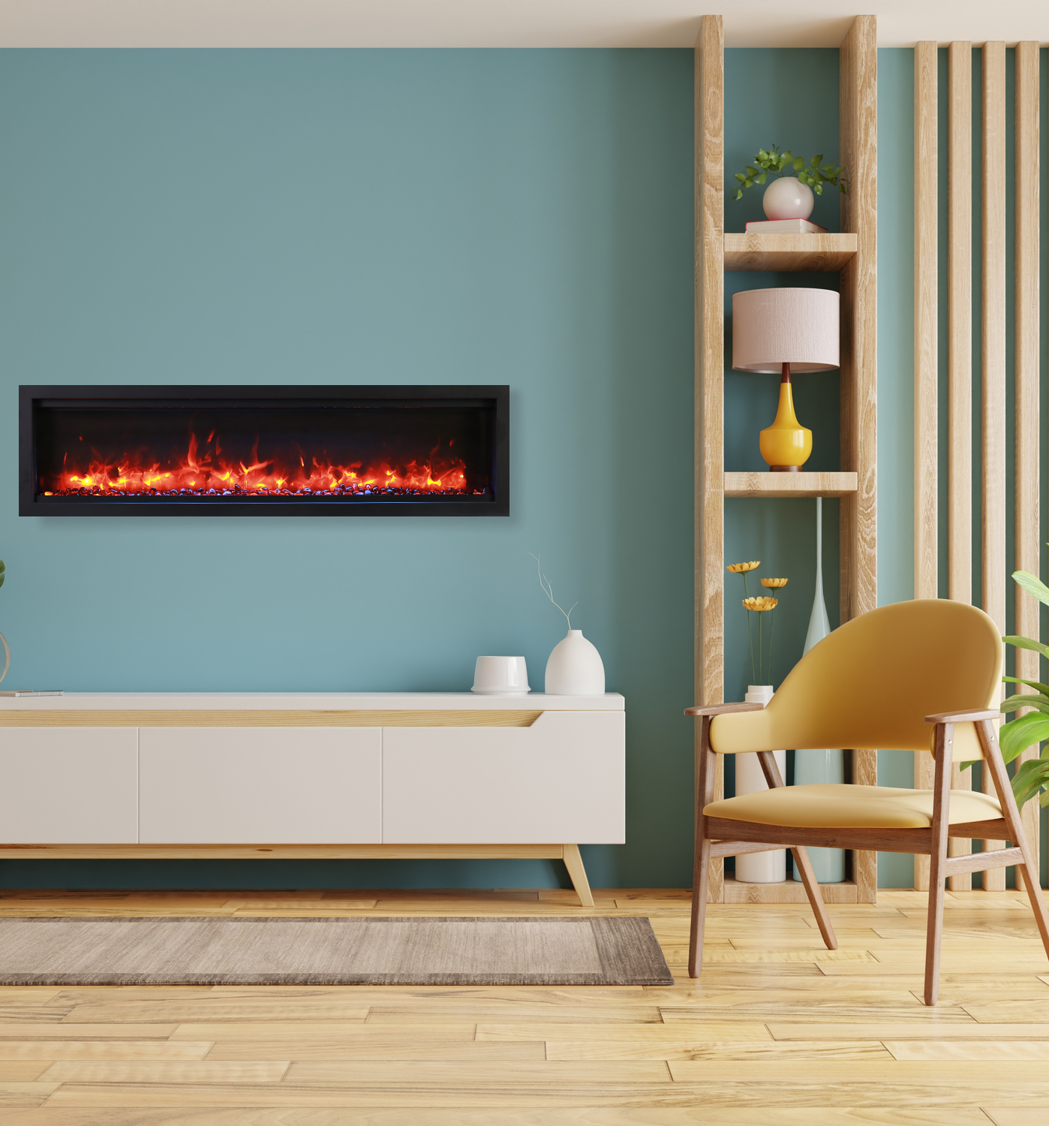
Remii WM
Electric Fireplace

Slide 11
Remii WM Electric Fireplace
Sizes : 34 Inch, 42 Inch, 50 Inch, 60 Inch, 74 Inch, 88 Inch, 100 Inch
Can be fully recessed or Semi Flush Mounted within a 2 x 4 wall.
Remii-XS surround required for semi flush mount applications
WiFi is compatible to connect and control the fireplace from your smartphone with the use of our app. Available on the Google Play Store and the Apple App Store
Three flame speed motor
Choose from combinations of yellow, orange, and red-colored flames
Two flame pattern styles – standard and more traditional
Flame operates with or without heat
Choose from 11 colors of canopy and ember bed lighting to illuminate decorative media from below and above
Touchpad for convenient control of features and temperature display on the fireplace
Programmable timer & thermostat allows you to decide the temperature of the room. Set your fireplace to turn on before you arrive home or have it automatically turn on when the weather is cold
A patented thermostatic remote comes included.

Slide 12
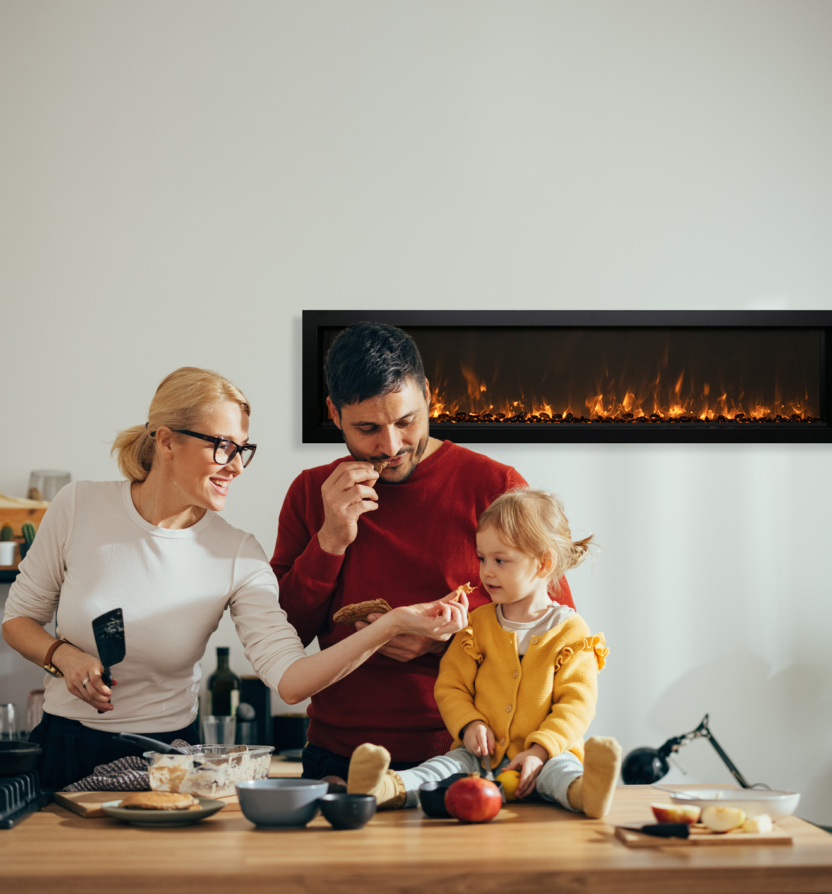
Remii WM SLIM
Electric Fireplace

Slide 13
Remii WM-SLIM Electric Fireplace
Sizes : 45 Inch, 55 inch, 65 Inch
Modern and sleek in design, this unit can be mounted or recessed into any 2” x 4” wall
Unsurpassed, realistic flames can be enjoyed with or without the use of heat, allowing for year-round use
Clean and Seamless in Design: this fireplace features a full-frame viewing area
WiFi controls come standard
Remote App- total control of your fireplace from the convenience of your mobile device
Operate this fireplace from the comfort of your favorite spot with the included, full feature, remote control
2 Heater settings Low 750W High 1465
5000 BTU’s
Media Kit includes: Clear glass diamonds, black powder-coated surround, and a full feature remote control
11 multi-colors of uplighting that accent from the tray
Flame options include: yellow, orange, and red. 5 settings in each color, so you can cycle through
3 Speed motor sets the flame speed option
Smart Heater Control – Auto mode feature allows for the unit to operate under your ideal temperature setting
Perfect for any commercial or residential space

Slide 14
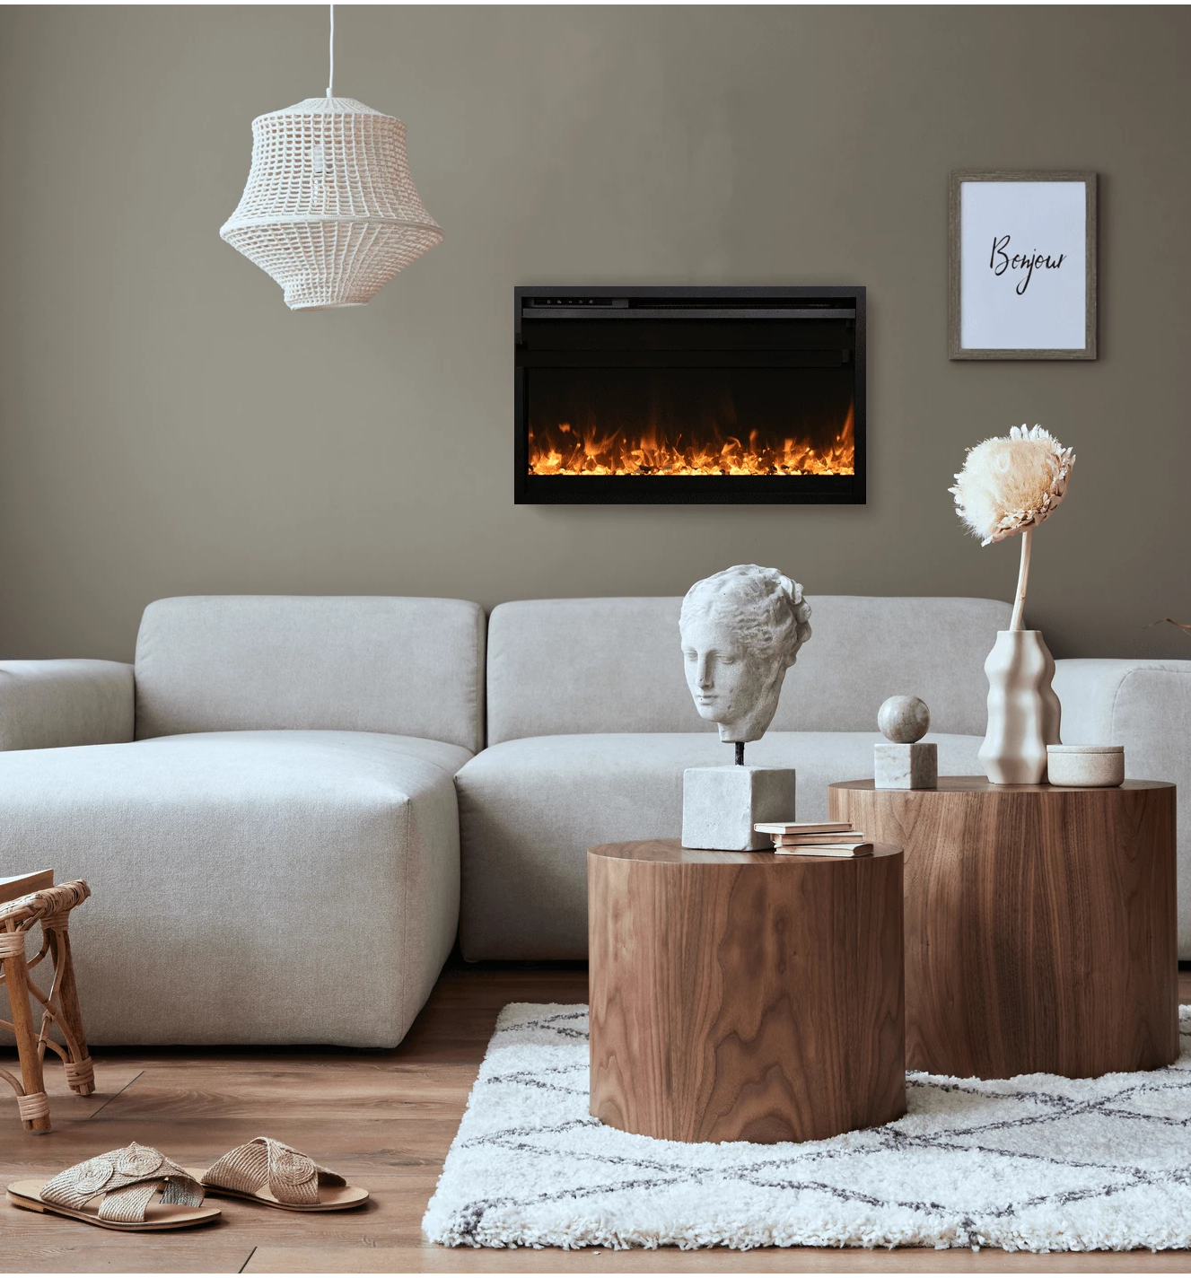
Remii CLASSIC SLIM
Electric Fireplace

Slide 15
Remii CLASSIC-SLIM Electric Fireplace
Sizes : 26 Inch, 30 Inch, 33 Inch
Modern and sleek in design, this unit can be mounted or recessed into any 2” x 4” wall
5000 BTU’s
Unsurpassed, realistic flames can be enjoyed with or without the use of heat, allowing for year-round use
Remote App – Total control of your fireplace from the convenience of your mobile device
Clean and Seamless in Design: This fireplace features a full-frame viewing area
Flame Styles – 11 multi-colors of uplighting that accent from the tray
WiFi controls come standard
Flame Presentation – yellow, orange, and red. 5 settings in each color, so you can cycle through
Smart Heater Control – Auto mode feature allows for the unit to operate under your ideal temperature setting
Perfect for any commercial or residential space
Operate this fireplace from the comfort of your favorite spot with the included, full feature, remote control
2 Heater settings Low 750W High 1465

Slide 16
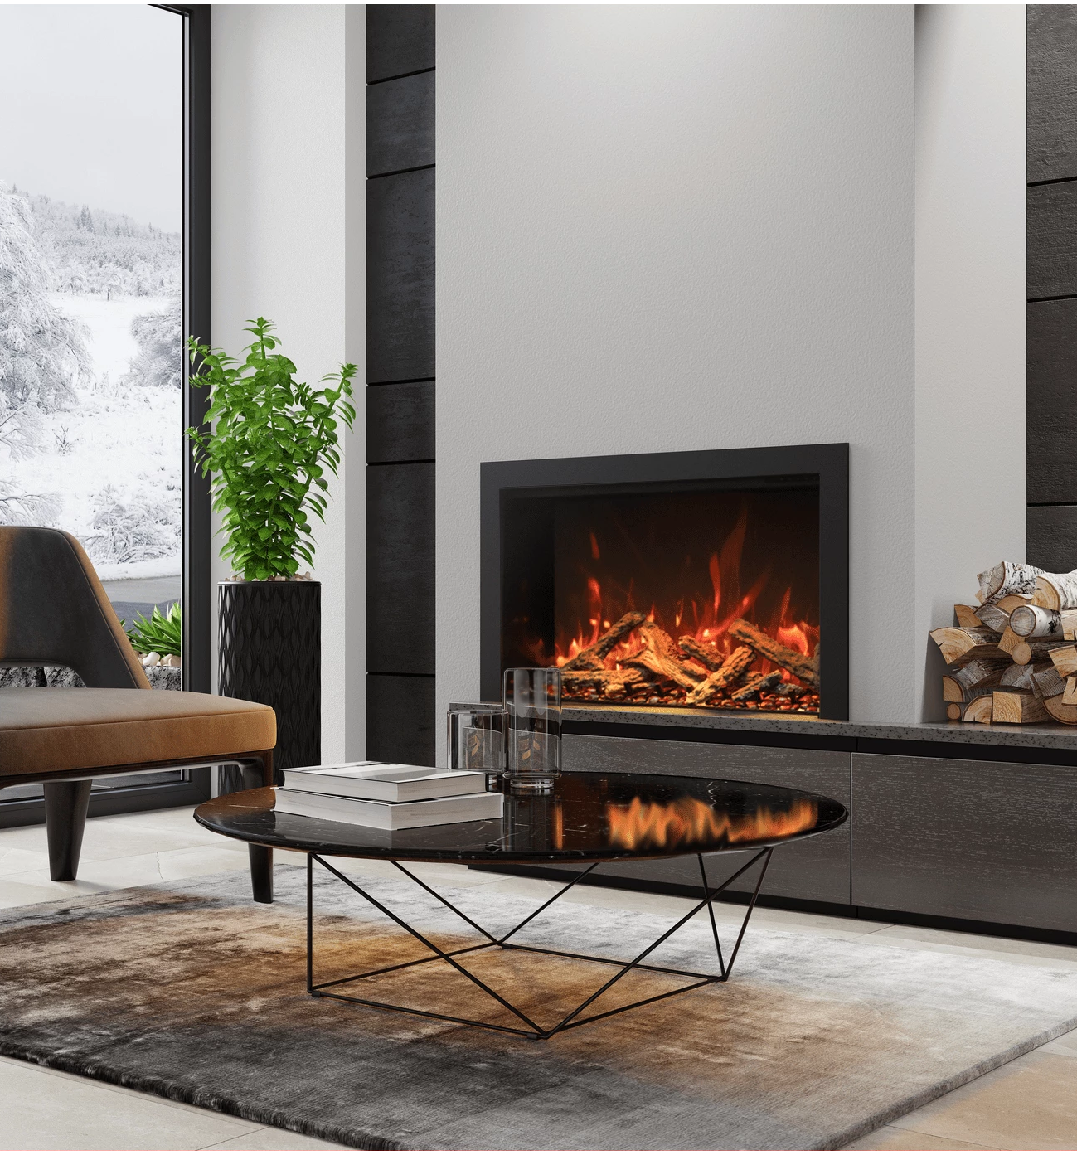
Remii CLASSIC
Electric Fireplace

Slide 17
Remii CLASSIC Electric Fireplace
Size: 26 Inch, 30 Inch, 33 Inch
Zero Emission – Compared to gas and wood, but with traditional looks
Hardwire Ready- Thermostat hard-wire ready
Indoor – Rated for Indoor Applications Only.
Remote control – For flame and heater
Heat – Can produce up to 1465W 5000 BTU heat, Heats approx. 400 sq ft
Flame Styles – Two Flame sets. Ambient canopy lighting in 10 colors illuminates media like never before with 1 cycle colors setting
Heat Flow – The heater is located on the inner top of the fireplace, thus allowing the heat to cascade down over the top of the glass.
Flame Presentation – State of the art flame presentation: Vibrant, multi-colored state of the art flame presentation – change from Yellow to Orange to Red with just a click of the remote.
Two-stage Heater – Flame operates with or without heat
Vents – Hidden venting allows for a true clean face appearance.

